Slide 1


5G Network: Future of Telecommunication
Reuben Perry
ISSC341: Introduction to Networking
Dr. Jose Bernier
28 January 2018

Slide 2
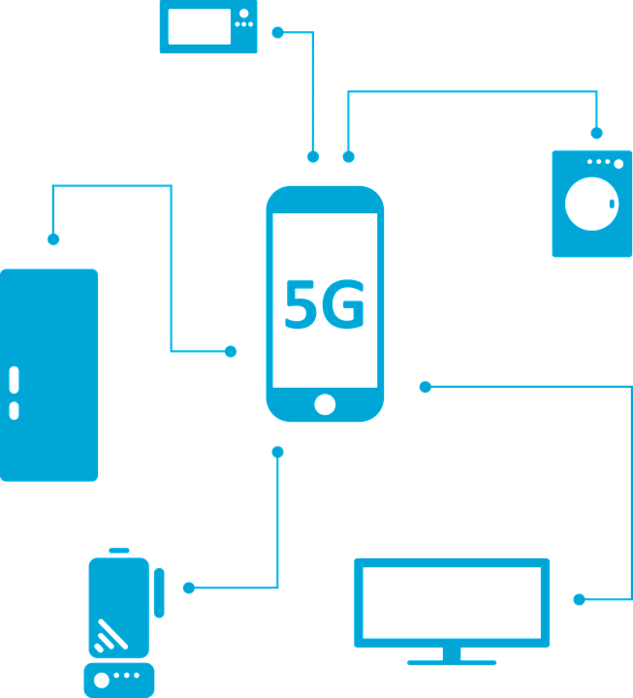
What is 5G?
5G is more than just a fast network
5G is expected to be 100x faster than 4G LTE
Max speed is expected to reach 20Gbps

Slide 3

History of Mobile Networks
1G: Introduced a whole new way to make phone calls
1st phone was $4,000
2G: Allowed text messaging
3G: First time phones could access the internet
4G: Higher speeds allowed video streaming
Struggles with High Definition
Higher demand with IoT (Internet of Things)

Slide 4

Technology Involved
Whole new Infrastructure is required
Support IoT and high definition requirements
Massive MIMO
Millimeter Waves

Slide 5

Millimeter Waves
Current mobile signals operate between 700 MHz – 2.6 GHz
Other wireless signals operate anywhere below 6 GHz
Operate at a frequency between 30 GHz – 300 GHz
Less distance and more interference

Slide 6

Small Cells
Utilized for stronger signals in crowded cities
Act as a hot spot
Placed every 250 meters
Thousands of small cells per city
Cities are already installing small cells

Slide 7
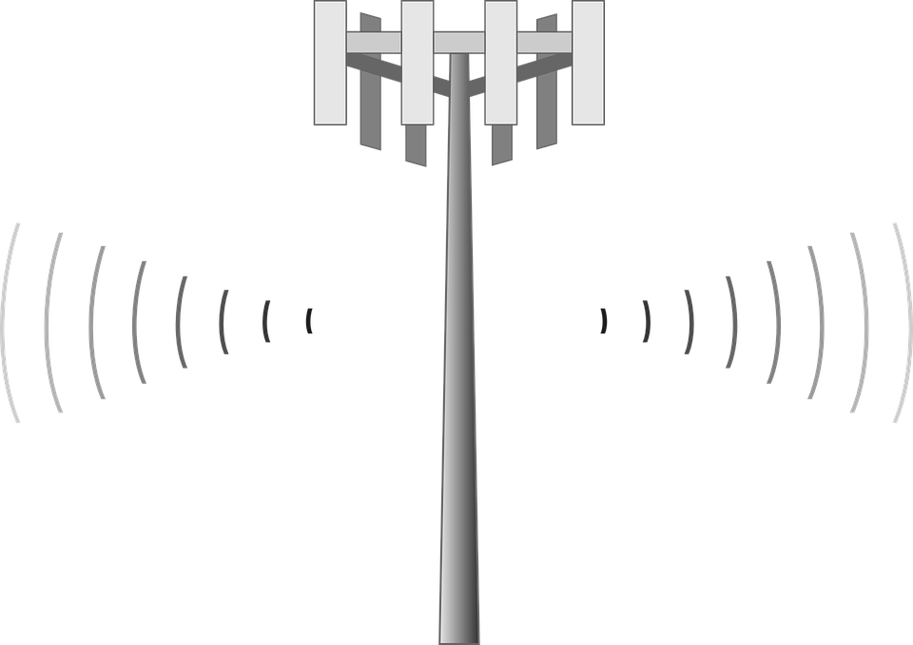
Massive MIMO
AKA Very Large MIMO, Hyper MIMO, Full-Dimension MIMO, and ARGOS
Towers will consist of 100 small antennas
Does not require large cell tower
Experimented by Verizon and Sprint
Beamforming to reduce wave interference

Slide 8

5G Possibilities
IoT
Smartwatches, smartglasses, autonomous cars, robots, etc
Autonomous Vehicles
Healthcare

Slide 9

Mobile Security
Higher security demand
Current Security:
Voice encryption
Sim cards
Data encryption
New security demands
Spliced network
New trust models

Slide 10

Companies Involved
Many phone companies claim to be the first to deploy 5G
Verizon expects to implement home 5G this year
T-Mobile wants to implement 5G on lower frequencies
Other notable companies
Qualcomm
Ericsson
Intel
Demonstrating 5G at winter Olympics
U.S. government invested $400 Million

Slide 11

Conclusion
5G is more than a faster network
Previous mobile generations led to where we are now
5G millimeter waves will operate at a higher frequency
30 GHz-300 GHz
Small Cells
Masisve MIMO
New possibilities
Higher security is required
Many companies involved

Slide 12
Reference List
5G Powered by Intel® Technology. (n.d.). Retrieved January 28, 2018, from https://www.intel.com/content/www/us/en/wireless-network/5g-technology-overview.html
Fact Sheet: Administration Announces an Advanced Wireless Research Initiative, Building on President's Legacy of Forward-Leaning Broadband Policy. (2016, July 15). Retrieved January 28, 2018, from https://obamawhitehouse.archives.gov/the-press-office/2016/07/15/fact-sheet-administration-announces-advanced-wireless-research
Johnson, J. (2018, January 19). This week in 5G: small cells everywhere! Retrieved January 28, 2018, from https://www.ctia.org/industry-data/blog-details/blog-posts/this-week-in-5g-small-cells-everywhere!
Kwadwo Agyapong, P., Iwamura, M., Staehle, D., Kiess, W., & Benjebbour, A. (2014, November 21 ). Design considerations for a 5G network architecture. IEEE Communications Magazine, 52(11), 65-75. doi:10.1109/MCOM.2014.6957145

Slide 13
Reference List
Larrson, E. G., Edfors, O., Tufvesson, F., & Marzetta, T. L. (2014, February). Massive MIMO for Next Generation Wireless Systems. IEEE Communications Magazine, 52(2), 186-195. doi:10.1109/ACCESS.2014.6736761
Legere, J. (2017, May 02). T-Mobile Announces Plans for Real Nationwide Mobile 5G. Retrieved January 28, 2018, from https://newsroom.t-mobile.com/news-and-blogs/nationwide-5g.htm
Mezzavilla, M. (2017, February 01). Retrieved January 28, 2018, from https://www.youtube.com/watch?v=TxbmIn1eMOQ
Newsroom. (2018, January 04). Retrieved January 28, 2018, from http://about.att.com/story/att_to_launch_mobile_5g_in_2018.html

Slide 14
Reference List
Nordrum, A., Clark, K., & IEEE Spectrum Staff. (2017, January 27). Everything You Need to Know About 5G. Retrieved January 28, 2018, from https://spectrum.ieee.org/video/telecom/wireless/everything-you-need-to-know-about-5g
Nordrum, A., Clark, K., & IEEE Spectrum Staff. (2017, August 19). 5G Bytes: Small Cells Explained. Retrieved January 28, 2018, from https://spectrum.ieee.org/video/telecom/wireless/5g-bytes-small-cells-explained
Nordrum, A., Clark, K., & IEEE Spectrum Staff. (2017, May 06). 5G Bytes: Millimeter Waves Explained. Retrieved January 28, 2018, from https://spectrum.ieee.org/video/telecom/wireless/5g-bytes-millimeter-waves-explained
Rappaport, T. S., Dr., Sun, S., Mayzus, R., Zhao, H., Azar, Y., Wang, K., . . . Gutierrez, F. (2013, May 10). Millimeter Wave Mobile Communications for 5G Cellular: It Will Work! IEEE Access, 1, 335-349. doi:10.1109/ACCESS.2013.226013
Young, R. (2017, November 30). The Future of Wireless Has Arrived. Retrieved January 28, 2018, from http://www.verizon.com/about/news/future-wireless-has-arrived

